Slide 1

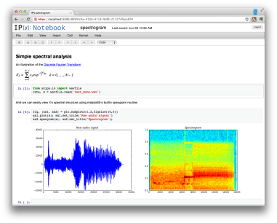



Architecture Diagram: “Zinvestor”
Raw Data
Data Storage
SQLite
Data Munging/Wrangling
Computation and Analysis
(e.g. Create New Variables)
Statistical Modeling
Data Ingestion
Python API Requests
Presentation
Zip code Data

Slide 2
Potential Edits
Add project description/goal at the top: “to predict drivers of Zestimate error for the DC real estate market”
Add subsequent slides that provide detail about the components of the project architecture(?) or add high level detail to process components in slide 1
Data Ingestion
Specify that requests are at the individual property level of granularity
Zip code level and neighborhood level data from both Zillow and opendata.gov will be used to provide neighborhood information
Data storage
Data from API can be flexibly stored in any delimited format
Zip code level and neighborhood level data from Zillow and opendata.gov appear to be natively stored in .csv format
Suggest using PostGRESQL
Data Munging
Merging zip code and neighborhood level data to property level data to create combined dataset with Zestimate, property details, and neighborhood/zip level details
Computation & Analysis
Creation of hypothesis-based variables to explain prediction errors
Statistical Modeling
Modeling to identify largest drivers of prediction error

